Slide 1
^{A Study To Predict} ^{Diabetes In} ^{Women}
^{By,}
^{Boddireddy Vikas Reddy}
^{Preethi Bommineni}
^{Kaparaju Naveen Kumar}

Slide 2
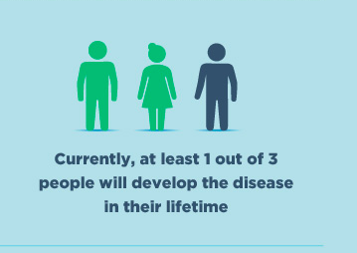
INTRODUCTION
Diabetes : A chronic health condition that affects how our body turns food into energy.
Over time diabetes can cause serious health problems , such as kidney failure , vision loss , heart stroke , premature death.
Risk factors:
Unhealthy diet
Aging
Obesity
Sex
Pregnancy
Body mass index (BMI)
Family history
By the study of Centers for Disease Control and Prevention (CDC) in 2022 , more than 130 million adults are living with diabetes or prediabetes in United States
Notes:
http://www.mayoclinic.org/diseases-conditions/diabetes/basics/definition/con-20033091

Slide 3
Data Collection
The data is collected from Pima Indian dataset from National Institute of Diabetes at the Johns Hopkins University.
Type of Study : Observational
No. of rows : 768
No. of columns : 9

Slide 4
Data Variables
Pregnancy: frequency of pregnancy
Glucose: Concentration of plasma glucose (mg/dL)
Blood pressure: Diastolic blood pressure (mm Hg)
Skin Thickness: Tricep skinfold thickness (mm)
Insulin: Two-hour serum insulin (mu U/ml)
BMI: Body mass index (kg/m2)
Pedigree: The likelihood of diabetes based on family history.
Age : Age of a person as per standards(Young Age 21-40 years, Middle Age 41-60 years, Elder and Wise Age 61- 85 years)
Outcome (Diabetes): diabetes status of a person

Slide 5
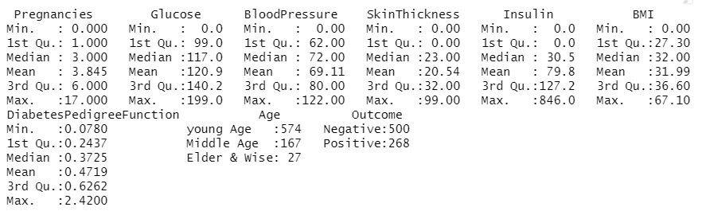
Summary Statistics

Slide 6
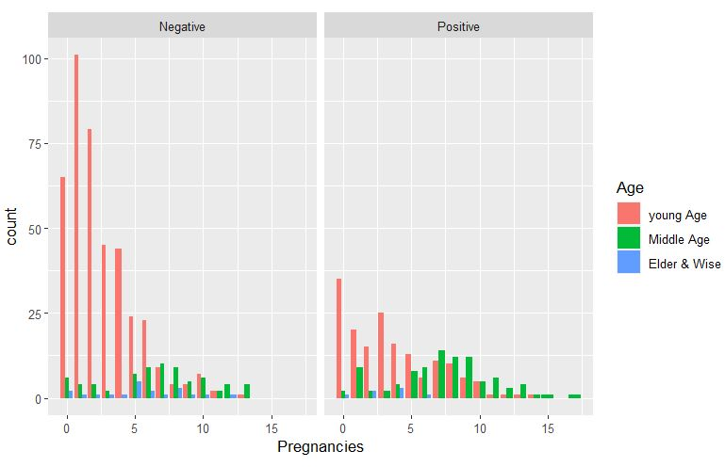
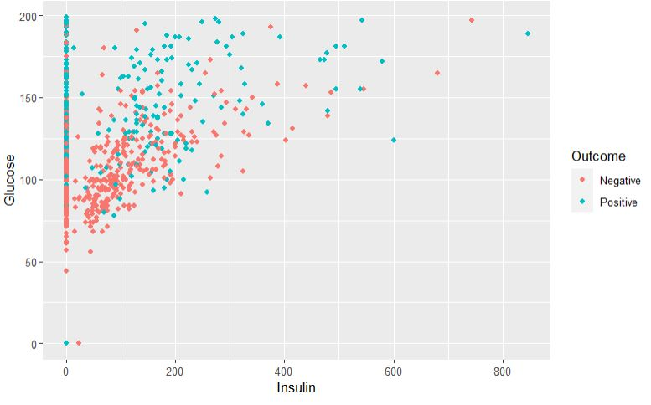
Graphical Analysis

Slide 7
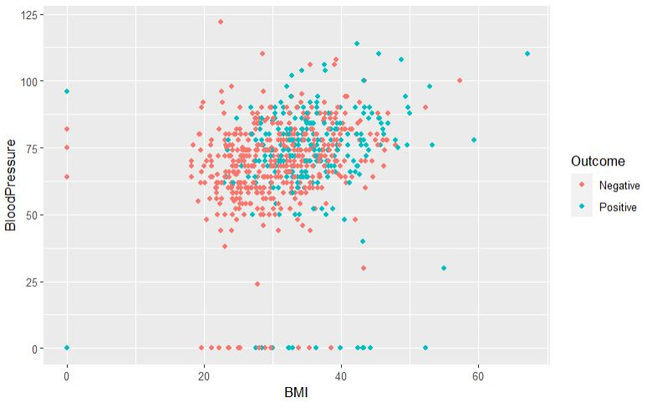
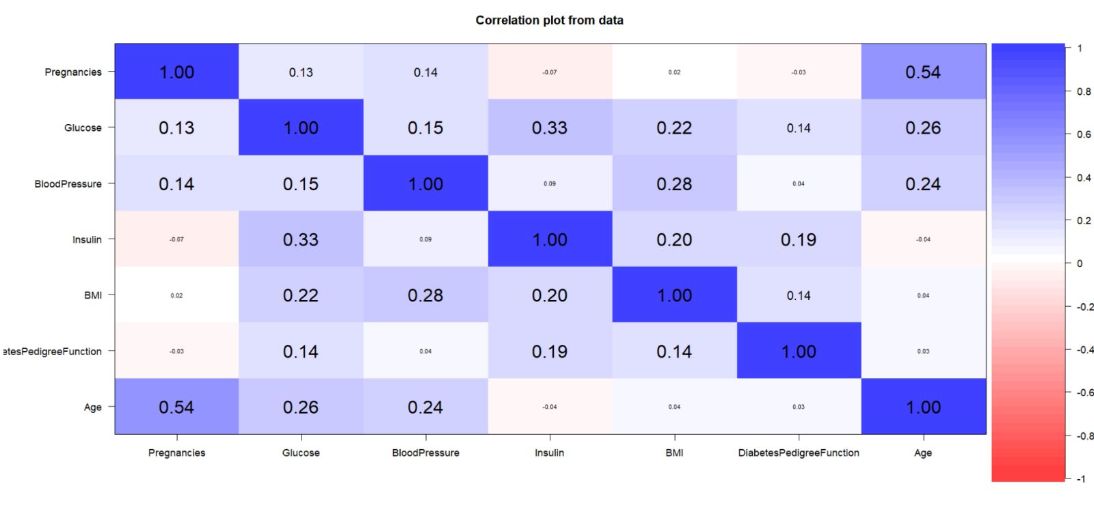
Graphical Analysis & Correlation Matrix

Slide 8
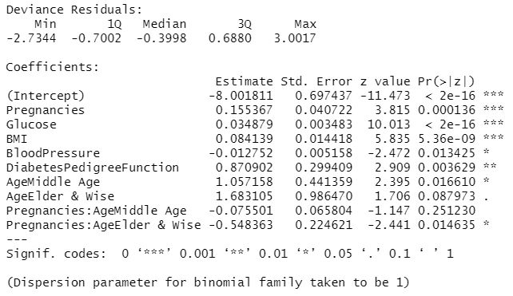
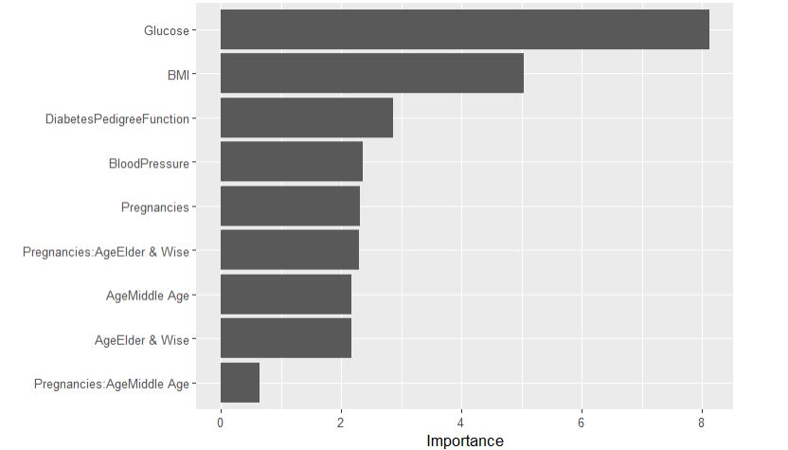
Significant Variables

Slide 9
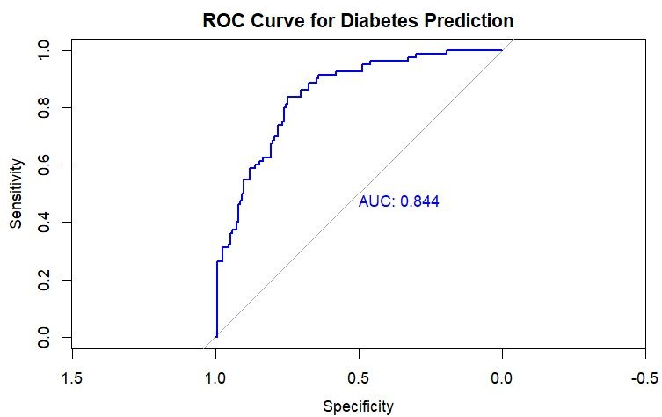
ROC Curve

Slide 10
Conclusion
The study aimed to predict the risk of diabetes in women using a multivariable logistic regression model.
The model showed an overall accuracy of 78%, sensitivity of 60%, specificity of 88%, and an area under the curve of 0.82.
The model is useful for predicting the risk of diabetes in women, but caution should be taken when using it as the sole diagnostic tool.
Future research should validate the findings in larger populations and explore using additional variables to improve sensitivity.

Slide 11
Limitations
Small dataset size of only 768 observations limits statistical power and generalizability.
High insulin levels observed in some observations may not be practical and could affect the validity of the results.
Limited factors considered in the dataset, additional factors such as diet, sedentary lifestyle, stress, and smoking may influence insulin levels.
The dataset only pertains to women from the Pima tribe living in Southern Arizona, which may limit the generalizability of the findings.
Notes:
http://www.cdc.gov/diabetes/home/

Slide 12
Future Works
This study used three models, random forests, XGBoost, and logistic regression, to predict outcomes in a dataset.
Results showed that the random forest model had the highest accuracy of 80%, while XGBoost had 74%, and logistic regression had 78%. The findings suggest that random forests may be the best model for this dataset, but further work is needed to improve accuracy.
Using multiple models can help predict outcomes in similar datasets.

Slide 13
Thank you

